Slide 1

EXPLOITATION FRAMEWORKS
Comparative Intelligence Analysis: WWII vs. Ukraine Commando Era
DOCUMENT: GIE-TECH-2026-042 | SPHINX SURVEILLANCE

Slide 2
ACTIVE INTELLIGENCE EXTRACTION
THE STRUCTURAL SHIFT
NON-PERMISSIVE SUCCESS
Intelligence gathering has evolved from passive post-war "vacuuming" to active, real-time "snatch-and-grab" operations embedded within high-intensity conflict zones.
Ukrainian Unit 2245, backed by MI6 and E Squadron, has effectively neutralized Russia's technological advantage through deep-penetration tactical seizure.

Slide 3
KEY INTELLIGENCE QUESTIONS
Strategic Mandates: How does WWII large-scale "vacuuming" compare with targeted real-time extraction in the Ukrainian theater?
Clandestine Methodologies: What are the operational roles and training pipelines for Unit 2245 and Operation Goldfish?
Reverse Engineering: Which Russian assets (EW, Comms, Radar) have been successfully exfiltrated and neutralized by Allied technicians?

Slide 4

OPERATION CYCLONE & WWII LEGACY
POST-CONFLICT VACUUMING
Operation Cyclone relied on mechanized "T-Forces" following vanguards to seize intact blueprints and labs. The environment was largely permissive once combat subsided.
Primary targets included German rocketry, jet propulsion, and chemical systems—focusing on wholesale asset acquisition rather than tactical snatching.

Slide 5

OPERATION GOLDFISH (2016-2026)
THE CLANDESTINE BLUEPRINT
Established as a secret partnership between CIA, MI6, AIVD, and HUR to train elite Ukrainian operators. Focus: Infiltrating hostile territories and stealing specialized secrets under deep-cover personas.
Training in Poland & Lithuania has fostered a new generation of high-tier intelligence officers.

Slide 6

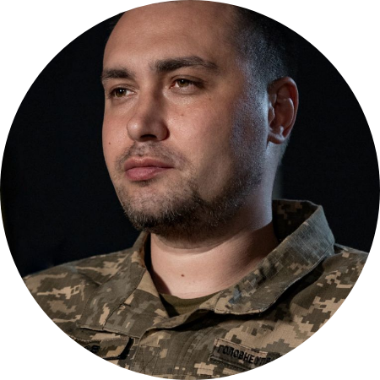
UNIT 2245: THE KINETIC SPEARHEAD
LEAD DIRECT-ACTION ARM
Unit 2245 (alumni including Gen. Budanov) executes high-risk raids behind Russian lines. Their doctrine emphasizes rapid equipment exfiltration and real-time ISR coordination.
They neutralize guard elements and physically exfiltrate hardware before counter-mechanized forces can react.

Slide 7






THE TRILATERAL EXPLOITATION TRIAD
MI6 TARGETING
E SQUADRON
UNIT 2245
Coordinates ISR data and strategic targeting. Identifies high-value Russian prototype locations for kinetic action.
Tactical overwatch and counter-surveillance. Acts as the "safety valve" for extraction under civilian cover.
Deep penetration and snatch-and-grab seizure. Kinetic spearhead responsible for the physical capture.

Slide 8
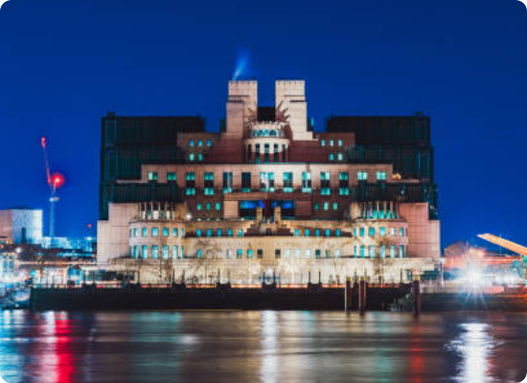
STRATEGIC OVERWATCH & THE INCREMENT
MI6 STRATEGIC ROLE
Managing high-level targeting and informant networks. SIS identifies precise prototype serials and passes actionable target packages to HUR commandos.

Slide 9

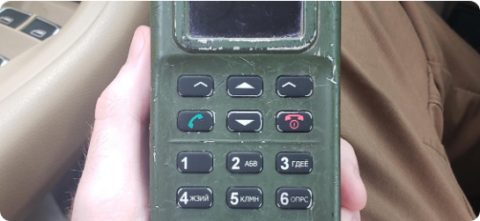
COMMANDO ERA TECHINT HARVEST
SYSTEM CRAB (EW)
R-187P1 AZART CRYPTO
Latest dome-protection tech. Capture allowed mapping frequency-hopping algorithms and neutralizing drone jamming.
Intact crypto-keys enabled real-time interception of Russian tactical battlefield movements and command directives.

Slide 10
TECHINT EXFILTRATION LOG DETAILS
Asset Category | Specific Systems | Exploitation Outcome
Air-Defense Radar | Pantsir-S1 / S-400 Arrays | Dissection of GNC boards revealed Western dual-use chips; loopholes closed.
Missile Guidance | Kh-101 Seeker Heads | Mapping anti-jamming properties of Kometa-M receivers; severing recon links.
UAV Avionics | Orlan-10 / Shahed Telemetry | Development of localized electronic countermeasures to spoof guidance mid-flight.

Slide 11
RISK-BENEFIT ANALYSIS
100%
STRATEGIC DOMINANCE
While Unit 2245 faces high attrition and E Squadron risks plausible deniability, the harvest allows for frictionless prototyping of countermeasures.
Benefit: Western defense firms now design counters that guarantee superiority for a generation.
Real-Time Interception

Slide 12
QUESTIONS?
Strategic Projection: The aggressive, real-time extraction matrix has permanently replaced the post-conflict model. Indicators monitor for anomalous special forces raids as new EW prototypes appear.
SPHINX SURVEILLANCE | TechINT Desk

Slide 13






IMAGE SOURCES
https://warfarehistorynetwork.com/wp-content/uploads/2024/07/W-Fal24-TopSec-V-2-1-2000x1526.jpg
Source: warfarehistorynetwork.com
https://lookaside.fbsbx.com/lookaside/crawler/media/?media_id=1457642249730854
Source: www.facebook.com
https://upload.wikimedia.org/wikipedia/commons/1/1a/Kyrylo_Budanov_%283x4_cropped%29.jpg?utm_source=en.wikipedia.org&utm_campaign=index&utm_content=original
Source: en.wikipedia.org
https://media.istockphoto.com/id/2196917834/photo/mi6-building-reflecting-on-thames-at-night-london-uk.jpg?s=612x612&w=0&k=20&c=8WF1q_ErEqUDGmP53zj2HR1hCDzgCFMkaWapKmn1W8o=
Source: www.istockphoto.com
https://lookaside.fbsbx.com/lookaside/crawler/media/?media_id=1421292679999387
Source: www.facebook.com
https://external-preview.redd.it/just-got-my-hands-on-an-azart-p1-russian-military-radio-its-v0-rGe40jBFWxXGpxAPx1neB4XY6N2XoArDfHkmVo1QZ-c.jpeg?auto=webp&s=aad0c5935e74cd1ec405bf46138661a409c24859
Source: www.reddit.com

